Slide 1
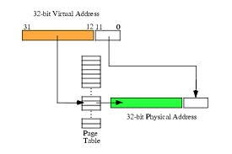
CS 345 Project 4
Virtual Memory Project

Slide 2
Learning Objectives…
Student explores the concepts of swap space, main memory, and virtual memory.
Understand the details of page faulting and page replacement algorithms, what memory access, hit and fault counts are, and how to track them.
Student implements a virtual address translation system (MMU) to Project 4 using a two-level hierarchical page table system.
An LC-3 processor is provided that makes all memory accesses through one function.
That’s right! You only need to implement one function for Project 4, namely, getMemAdr().

Slide 3
Virtual Memory
Virtual
Address
f (va)
Physical
Address
LC-3
MMU
LC-3
Memory
2¹⁶ Words
getMemAdr()
(Hardware)
→PC-Relative
→Indirect
→Base+Offset
IR, TRAP
LD, LDR, LDI
ST, STR, STI
OS Clock
Replacement Algorithm
Paged
Swap Space

Slide 4
Project 4 – Virtual Memory
unsigned short int *getMemAdr(int va, int rwFlg)
{
unsigned short int pa;
// turn off virtual addressing for system RAM
if (va < 0x3000) return &memory[va];
// calculate physical from virtual address
pa = va;
// return physical memory address
return &memory[pa];
} // end getMemAdr
Notes:
4

Slide 5
Crawler, Memtest
Welcome to OS345 Rev 1.1
0>>crawler
178068>>
Crawler R1.1
Process 1: Move #1 to xE29E
Process 1: Move #2 to x6B3F
…
Process 1: Move #99 to x932E
Process 1: Move #100 to xDA8F
Process #1 Halted at 0x937e
1807827>>memtest
MemTest R1.0a
(1) Round 1, Writing to memory...
(1) Round 1, Verifying...
(1) Round 2, Writing to memory...lt
# TID name address line prior time semaphore status
0 0/0 CLI 403b61 457 5 1 Running
1 1/0 LC3 MemTest 40190c 0 5 1 Waiting
1911162>>
(1) Round 2, Verifying...
(1) Round 3, Writing to memory...
(1) Round 3, Verifying...
…
(1) Round 10, Writing to memory...
(1) Round 10, Verifying...
Process #1 Halted at 0x305c
Notes:
5

Slide 6
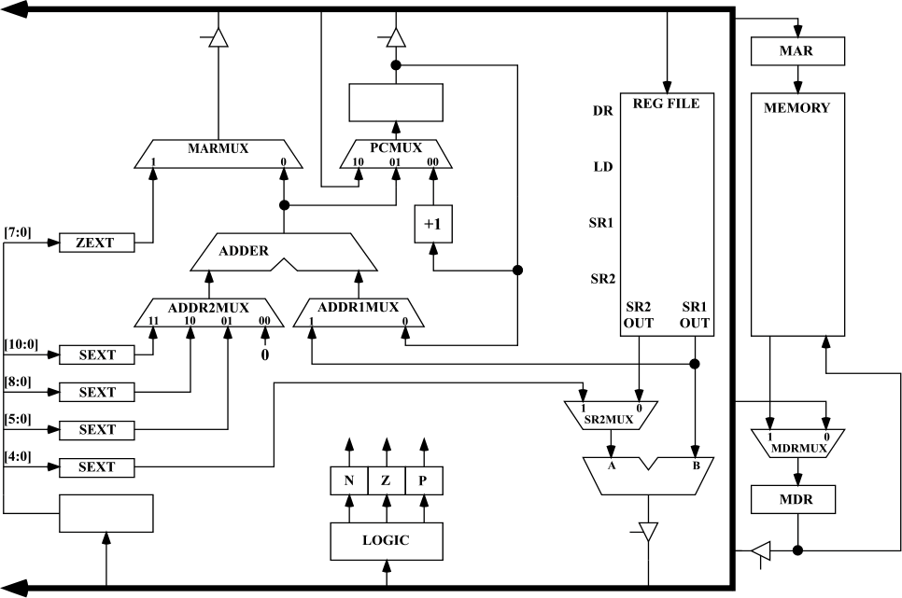
LC-3 Simulator
Project 4
MAR access thru getMemAdr(va, rwflg)
MDR access thru getMemData(va)
setMemData(va)
Notes:
6

Slide 7
Two-Level Paging System
Virtual Address
15 … 11 10 … 6 5 … 0
RPTE #
UPTE #
Frame Offset
Root Page Table
User Page Table
LC-3 Main Memory
+
Flags / Frame #
Flags / UPT #
+
Frame<<6
Offset
15 … 6 5 … 0
tcb[curTask].RPT
One per process
Physical Address

Slide 8
Virtual Memory
x0000
System (unmapped)
Virtual Address
x2000
Frame Table
All tables in LC-3 memory.
All memory accesses thru getMemAdr().
RPT’s pinned.
Each process has an RPT pointer (swapped on context switch).
x2400
RPT’s (Pinned)
x3000
UPT’s
(Swappable Frames)
User Frames
Paged
Swap
Space
Memory Limit
(Variable)
xFFFF
Notes:
8

Slide 9
#defines…
2¹⁶ Words
#define LC3_MAX_MEMORY 65536
#define LC3_FRAME_SIZE 64
#define LC3_FRAMES 1024
#define LC3_FBT 0x2000
#define LC3_RPT 0x2400
#define LC3_RPT_END 0x2800
#define LC3_MEM 0x3000
#define LC3_MEM_END 0x10000
#define LC3_MAX_PAGE (LC3_FRAMES<<2)
#define LC3_MAX_SWAP_MEMORY (LC3_MAX_PAGE<<6)
#define LC3_FBT_FRAME (LC3_FBT>>6)
#define LC3_RPT_FRAME (LC3_RPT>>6)
#define LC3_RPT_END_FRAME (LC3_RPT_END>>6)
#define LC3_MEM_FRAME (LC3_MEM>>6)
#define LC3_MEM_END_FRAME (LC3_MEM_END>>6)
// parts of a virtual address
#define RPTI(va) (((va)&BITS_15_11_MASK)>>10)
#define UPTI(va) (((va)&BITS_10_6_MASK)>>5)
#define FRAMEOFFSET(va) ((va)&BITS_5_0_MASK)
2⁶ Words
2¹⁶ / 2⁶ = 2¹⁰ Frames
Frame Bit Table
Root Page Tables
Start User Memory
Root Page Table Index
User Page Table Index

Slide 10
#defines…
// definitions within a root or user table page
#define DEFINED(e1) ((e1)&BIT_15_MASK)
#define DIRTY(e1) ((e1)&BIT_14_MASK)
#define REFERENCED(e1) ((e1)&BIT_13_MASK)
#define PINNED(e1) ((e1)&BIT_12_MASK)
#define FRAME(e1) ((e1)&BITS_9_0_MASK)
#define PAGED(e2) ((e2)&BIT_15_MASK)
#define SWAPPAGE(e2) ((e2)&BITS_12_0_MASK)
#define MEMWORD(a) (memory[a])
#define MEMLWORD(a) ((memory[a]<<16)+memory[(a)+1])
#define SET_DEFINED(e1) ((e1)|BIT_15_MASK)
#define SET_DIRTY(e1) ((e1)|BIT_14_MASK)
#define SET_REF(e1) ((e1)|BIT_13_MASK)
#define SET_PINNED(e1) ((e1)|BIT_12_MASK)
#define SET_PAGED(e2) ((e2)|BIT_15_MASK)
#define CLEAR_DEFINED(e1) ((e1)&~BIT_15_MASK)
#define CLEAR_DIRTY(e1) ((e1)&~BIT_14_MASK)
#define CLEAR_REF(e1) ((e1)&~BIT_13_MASK)
#define CLEAR_PINNED(e1) ((e1)&~BIT_12_MASK)

Slide 11
Page Table Entry
4 bytes
 |  |  |  |  |  | Frame # (0 – 1023)
F | D | R | P | - | - | f | f | f | f | f | f | f | f | f | f
 |  |  |  | Page # (0 – 8191)
S | - | - | p | p | p | p | p | p | p | p | p | p | p | p | p
• Frame valid (1 bit): one if referenced frame is in main memory; zero otherwise.
• Dirty (1 bit): one if referenced frame has been altered; zero otherwise.
• Reference (1 bit): one if frame has been referenced; zero otherwise.
• Pinned (1 bit): one if frame is pinned in memory; zero otherwise.
• Frame number (10 bits): If referenced page is in memory, this value specifies which frame it occupies. (1024 frames × 64 words = 2¹⁰ × 2⁶ = 2¹⁶ bytes = 65536 words.)
• Swap valid (1 bit): one if referenced page has been allocated in swap space; zero otherwise.
• Swap page number (13 bits). This specifies where referenced page is stored in swap space. When you load a page into memory, you should include this value in your frame table summary. (8,192 pages × 128 bytes = 2¹³ × 2⁷ = 2²⁰ bytes = 1,048,576 bytes.)
Notes:
11

Slide 12
Virtual to Physical Address
memory[taskRPT + ((((va)&0xf800)>>11)<<1)]
memory[(rpte1&0x03ff)<<6+((((va)&0x7c0)>>6)<<1)]
&memory[(upte1&0x03ff)<<6+((va)&0x003f)]
rpte1 = MEMWORD(taskRPT + RPTI(va));
upte1 = MEMWORD((FRAME(rpte1)<<6) + UPTI(va));
&memory[(FRAME(upte1)<<6) + FRAMEOFFSET(va)];

Slide 13
Global Clock
Swap Space
RPTE’s
UPTE’s
Frame’s
Notes:
13

Slide 14
8 Frame Exercise

Slide 15
VM Exercise (8 Frames)…
Project 4
FR____|S____
x3000
(192)
Frame
Page
Virtual
Address
Physical
Address
x2400
RPT0
00____|0____
00____|0____
00____|0____
00____|0____
00____|0____
00____|0____
00____|0____
00____|0____
...
00____|0____
00____|0____
00____|0____
00____|0____
00____|0____
x0000–x07FF
x0800–x0FFF
x1000–x17FF
x1800–x1FFF
x2000–x27FF
x2800–x2FFF
x3000–x37FF
x3800–x3FFF
...
xD800–xDFFF
xE000–xE7FF
xE800–xEFFF
xF000–xF7FF
xF800–xFFFF
x3040
(193)
x3080
(194)
x30C0
(195)
x3100
(196)
x2440
RPT1
00____|0____
00____|0____
00____|0____
00____|0____
...
x3140
(197)
x3180
(198)
x31C0
(199)
x3200

Slide 16
VM Exercise (8 Frames)…
Project 4
FR____|S____
x3000
(192)
Frame
Page
00____|0____
00____|0____
...
00____|0____
x3000–x303F
x3040–x307F
...
x3780–x37FF
Virtual
Address
Physical
Address
x2400
RPT0
11_193
00____|0____
00____|0____
00____|0____
00____|0____
00____|0____
00____|0____
00____|0____
00____|0____
...
00____|0____
00____|0____
00____|0____
00____|0____
00____|0____
x0000–x07FF
x0800–x0FFF
x1000–x17FF
x1800–x1FFF
x2000–x27FF
x2800–x2FFF
x3000–x37FF
x3800–x3FFF
...
xD800–xDFFF
xE000–xE7FF
xE800–xEFFF
xF000–xF7FF
xF800–xFFFF
0x3000
⇒ 0x3040
x3040
(193)
0x3001
⇒ 0x3041
x3000-x303F
Data Frame
x3080
(194)
x240C
11_192
x30C0
(195)
x3100
(196)
x2440
RPT1
00____|0____
00____|0____
00____|0____
00____|0____
...
x3140
(197)
x3180
(198)
x31C0
(199)
x3200

Slide 17
VM Exercise (8 Frames)…
Project 4
FR____|S____
x3000
(192)
Frame
Page
11_193|0____
00____|0____
...
00____|0____
Virtual
Address
Physical
Address
x2400
RPT0
00____|0____
00____|0____
00____|0____
00____|0____
00____|0____
00____|0____
11_192|0____
00____|0____
...
00____|0____
00____|0____
00____|0____
00____|0____
00____|0____
11_194
x0000–x07FF
x0800–x0FFF
x1000–x17FF
x1800–x1FFF
x2000–x27FF
x2800–x2FFF
x3000–x37FF
x3800–x3FFF
...
xD800–xDFFF
xE000–xE7FF
xE800–xEFFF
xF000–xF7FF
xF800–xFFFF
0x3000
⇒ 0x3040
x3040
(193)
0x3001
⇒ 0x3041
x3000-x303F
Data Frame
0x3040
⇒ 0x3080
0x3041
⇒ 0x3081
x3080
(194)
x3040-x307F
Data Frame
x30C0
(195)
x3100
(196)
x2440
RPT1
00____|0____
00____|0____
00____|0____
00____|0____
...
x3140
(197)
x3180
(198)
x31C0
(199)
x3200

Slide 18
VM Exercise (8 Frames)…
Project 4
FR____|S____
x3000
(192)
Frame
Page
11_193|0____
11_194|0____
...
00____|0____
Virtual
Address
Physical
Address
x2400
RPT0
00____|0____
00____|0____
00____|0____
00____|0____
00____|0____
00____|0____
11_192|0____
00____|0____
...
00____|0____
00____|0____
00____|0____
00____|0____
00____|0____
x0000–x07FF
x0800–x0FFF
x1000–x17FF
x1800–x1FFF
x2000–x27FF
x2800–x2FFF
x3000–x37FF
x3800–x3FFF
...
xD800–xDFFF
xE000–xE7FF
xE800–xEFFF
xF000–xF7FF
xF800–xFFFF
0x3000
⇒ 0x3040
x3040
(193)
0x3001
⇒ 0x3041
x3000-x303F
Data Frame
0x3040
⇒ 0x3080
0x3041
⇒ 0x3081
x3080
(194)
0xEFD2
⇒ 0x3112
x3040-x307F
Data Frame
x30C0
(195)
00____|0____
00____|0____
...
00____|0____
xE800–xE83F
xE840–xE87F
...
xEF80–xEFFF
11_195
x3100
(196)
11_196
x2440
RPT1
xEF80-xEFFF
Data Frame
00____|0____
00____|0____
00____|0____
00____|0____
...
x3140
(197)
x3180
(198)
x31C0
(199)
x3200

Slide 19
VM Exercise (8 Frames)…
Project 4
FR____|S____
x3000
(192)
Frame
Page
11_193|0____
11_194|0____
...
00____|0____
Virtual
Address
Physical
Address
x2400
RPT0
00____|0____
00____|0____
00____|0____
00____|0____
00____|0____
00____|0____
11_192|0____
00____|0____
...
00____|0____
00____|0____
11_195|0____
00____|0____
00____|0____
x0000–x07FF
x0800–x0FFF
x1000–x17FF
x1800–x1FFF
x2000–x27FF
x2800–x2FFF
x3000–x37FF
x3800–x3FFF
...
xD800–xDFFF
xE000–xE7FF
xE800–xEFFF
xF000–xF7FF
xF800–xFFFF
0x3000
⇒ 0x3040
x3040
(193)
0x3001
⇒ 0x3041
x3000-x303F
Data Frame
0x3040
⇒ 0x3080
0x3041
⇒ 0x3081
x3080
(194)
0xEFD2
⇒ 0x3112
x3040-x307F
Data Frame
0xD851
⇒ 0x3191
x30C0
(195)
00____|0____
00____|0____
...
11_196|0____
11_197
x3100
(196)
x2440
RPT1
xEF80-xEFFF
Data Frame
00____|0____
00____|0____
00____|0____
00____|0____
...
x3140
(197)
00____|0____
00____|0____
...
00____|0____
xD800–xD83F
xD840–xD87F
...
xDF80–xDFFF
11_198
x3180
(198)
xD840-xD87F
Data Frame
x31C0
(199)
x3200

Slide 20
VM Exercise (8 Frames)…
Project 4
FR____|S____
x3000
(192)
Frame
Page
11_193|0____
11_194|0____
...
00____|0____
Virtual
Address
Physical
Address
x2400
RPT0
00____|0____
00____|0____
00____|0____
00____|0____
00____|0____
00____|0____
11_192|0____
00____|0____
...
11_197|0____
00____|0____
11_195|0____
00____|0____
00____|0____
x0000–x07FF
x0800–x0FFF
x1000–x17FF
x1800–x1FFF
x2000–x27FF
x2800–x2FFF
x3000–x37FF
x3800–x3FFF
...
xD800–xDFFF
xE000–xE7FF
xE800–xEFFF
xF000–xF7FF
xF800–xFFFF
0x3000
⇒ 0x3040
x3040
(193)
0x3001
⇒ 0x3041
x3000-x303F
Data Frame
0x3040
⇒ 0x3080
0x3041
⇒ 0x3081
x3080
(194)
0xEFD2
⇒ 0x3112
x3040-x307F
Data Frame
0xD851
⇒ 0x3191
0xD833
⇒ 0x31F3
x30C0
(195)
00____|0____
00____|0____
...
11_196|0____
x3100
(196)
x2440
RPT1
xEF80-xEFFF
Data Frame
00____|0____
00____|0____
00____|0____
00____|0____
...
x3140
(197)
00____|0____
11_198|0____
...
00____|0____
xD800–xD83F
xD840–xD87F
...
xDF80–xDFFF
11_199
Now What?
No more available frames!
x3180
(198)
xD840-xD87F
Data Frame
x31C0
(199)
xD800-xD83F
Data Frame
x3200

Slide 21
VM Exercise (8 Frames)…
Project 4
FR____|S____
x3000
(192)
Frame
Page
10_193
Virtual
Address
Physical
Address
x2400
RPT0
11_193|0____
11_194|0____
...
00____|0____
00____|0____
00____|0____
00____|0____
00____|0____
00____|0____
00____|0____
11_192|0____
00____|0____
...
11_197|0____
00____|0____
11_195|0____
00____|0____
00____|0____
x0000–x07FF
x0800–x0FFF
x1000–x17FF
x1800–x1FFF
x2000–x27FF
x2800–x2FFF
x3000–x37FF
x3800–x3FFF
...
xD800–xDFFF
xE000–xE7FF
xE800–xEFFF
xF000–xF7FF
xF800–xFFFF
10_194
x0000–x07FF
x0800–x0FFF
x1000–x17FF
x1800–x1FFF
x2000–x27FF
x2800–x2FFF
x3000–x37FF
x3800–x3FFF
...
xD800–xDFFF
xE000–xE7FF
xE800–xEFFF
xF000–xF7FF
xF800–xFFFF
0x3000
⇒ 0x3040
x3040
(193)
0x3001
⇒ 0x3041
x3000-x303F
Data Frame
0x3040
⇒ 0x3080
0x3041
⇒ 0x3081
x3080
(194)
0xEFD2
⇒ 0x3112
10_192
0xD851
⇒ 0x3191
10_192
x3040-x307F
Data Frame
0xD833
⇒ 0x31F3
x30C0
(195)
0x3833
10_197
00____|0____
00____|0____
...
11_196|0____
10_197
10_195
10_195
x3100
(196)
10_196
x2440
RPT1
xEF80-xEFFF
Data Frame
00____|0____
00____|0____
00____|0____
00____|0____
...
x3140
(197)
11_199|0____
11_198|0____
...
00____|0____
10_199
10_198
x3180
(198)
xD840-xD87F
Data Frame
x31C0
(199)
xD800-xD83F
Data Frame
x3200

Slide 22
VM Exercise (8 Frames)…
Project 4
FR____|S____
x3000
(192)
Frame
Page
10_193|0____
10_194|0____
...
00____|0____
Virtual
Address
Physical
Address
x2400
RPT0
0xxxxx|1___0
00____|0____
00____|0____
00____|0____
00____|0____
00____|0____
00____|0____
10_192|0____
00____|0____
...
10_197|0____
00____|0____
10_195|0____
00____|0____
00____|0____
x0000–x07FF
x0800–x0FFF
x1000–x17FF
x1800–x1FFF
x2000–x27FF
x2800–x2FFF
x3000–x37FF
x3800–x3FFF
...
xD800–xDFFF
xE000–xE7FF
xE800–xEFFF
xF000–xF7FF
xF800–xFFFF
0xxxxx|1___1
x0000–x07FF
x0800–x0FFF
x1000–x17FF
x1800–x1FFF
x2000–x27FF
x2800–x2FFF
x3000–x37FF
x3800–x3FFF
...
xD800–xDFFF
xE000–xE7FF
xE800–xEFFF
xF000–xF7FF
xF800–xFFFF
0x3000
⇒ 0x3040
x3040
(193)
00____|0____
00____|0____
...
00____|0____
x3800–x383F
x3840–x387F
...
x3F80–x3FFF
0x3001
⇒ 0x3041
x3000-x303F
Data Frame
0x3040
⇒ 0x3080
11_194
0x3041
⇒ 0x3081
x3080
(194)
0xEFD2
⇒ 0x3112
x3800-x383F
Data Frame
#0 – x3000
x3800-x383F
Data Frame
0xD851
⇒ 0x3191
x3040-x307F
Data Frame
0xD833
⇒ 0x31F3
11_193
#1 – x3040
x30C0
(195)
00____|0____
00____|0____
...
10_196|0____
0x3833
⇒ 0x30B3
x3100
(196)
x2440
RPT1
xEF80-xEFFF
Data Frame
00____|0____
00____|0____
00____|0____
00____|0____
...
x3140
(197)
10_199|0____
10_198|0____
...
00____|0____
x3180
(198)
xD840-xD87F
Data Frame
x31C0
(199)
xD800-xD83F
Data Frame
x3200

Slide 23
VM Exercise (8 Frames)…
Project 4
FR____|S____
x3000
(192)
Frame
Page
0xxxxx|1___0
0xxxxx|1___1
...
00____|0____
x3000–x303F
x3040–x307F
...
x3780–x37FF
Virtual
Address
Physical
Address
x2400
RPT0
11_199|1___0
00____|0____
00____|0____
00____|0____
00____|0____
00____|0____
00____|0____
10_192|0____
11_193|0____
...
10_197|0____
00____|0____
10_195|0____
00____|0____
00____|0____
x0000–x07FF
x0800–x0FFF
x1000–x17FF
x1800–x1FFF
x2000–x27FF
x2800–x2FFF
x3000–x37FF
x3800–x3FFF
...
xD800–xDFFF
xE000–xE7FF
xE800–xEFFF
xF000–xF7FF
xF800–xFFFF
x0000–x07FF
x0800–x0FFF
x1000–x17FF
x1800–x1FFF
x2000–x27FF
x2800–x2FFF
x3000–x37FF
x3800–x3FFF
...
xD800–xDFFF
xE000–xE7FF
xE800–xEFFF
xF000–xF7FF
xF800–xFFFF
0x3000
⇒ 0x3040
x3040
(193)
00____|0____
11_194|0____
...
00____|0____
0x3001
⇒ 0x3041
x3000-x303F
Data Frame
0x3040
⇒ 0x3080
0x3041
⇒ 0x3081
x3080
(194)
0xEFD2
⇒ 0x3112
11_192
x3800-x383F
Data Frame
#0 – x3000
0xD851
⇒ 0x3191
x3040-x307F
Data Frame
0xD833
⇒ 0x31F3
10_193
#1 – x3040
x30C0
(195)
00____|0____
00____|0____
...
10_196|0____
#2 – xD800
0x3833
⇒ 0x30B3
0x3000
⇒ 0x31C0
x3100
(196)
x2440
RPT1
xEF80-xEFFF
Data Frame
00____|0____
00____|0____
00____|0____
00____|0____
...
x3140
(197)
10_199|0____
10_198|0____
...
00____|0____
0xxxxx|1___2
x3180
(198)
xD840-xD87F
Data Frame
x31C0
(199)
xD800-xD83F
Data Frame
x3000-x303F
Data Frame
x3200

Slide 24
VM Exercise (8 Frames)…
Project 4
FR____|S____
x3000
(192)
Frame
Page
11_199|1___0
0xxxxx|1___1
...
00____|0____
Virtual
Address
Physical
Address
x2400
RPT0
00____|0____
00____|0____
00____|0____
00____|0____
00____|0____
00____|0____
11_192|0____
10_193|0____
...
10_197|0____
00____|0____
10_195|0____
00____|0____
00____|0____
x0000–x07FF
x0800–x0FFF
x1000–x17FF
x1800–x1FFF
x2000–x27FF
x2800–x2FFF
x3000–x37FF
x3800–x3FFF
...
xD800–xDFFF
xE000–xE7FF
xE800–xEFFF
xF000–xF7FF
xF800–xFFFF
x0000–x07FF
x0800–x0FFF
x1000–x17FF
x1800–x1FFF
x2000–x27FF
x2800–x2FFF
x3000–x37FF
x3800–x3FFF
...
xD800–xDFFF
xE000–xE7FF
xE800–xEFFF
xF000–xF7FF
xF800–xFFFF
0x3000
⇒ 0x3040
x3040
(193)
00____|0____
11_194|0____
...
00____|0____
0x3001
⇒ 0x3041
x3000-x303F
Data Frame
0x3040
⇒ 0x3080
0x3041
⇒ 0x3081
x3080
(194)
0xEFD2
⇒ 0x3112
x3800-x383F
Data Frame
#0 – x3000
0xD851
⇒ 0x3191
x3040-x307F
Data Frame
0xD833
⇒ 0x31F3
x30C0
(195)
#1 – x3040
0x3833
⇒ 0x30B3
0xxxxx|1___4
00____|0____
00____|0____
...
10_196|0____
#2 – xD800
0x3000
⇒ 0x31C0
#3 – xD840
0xF745
⇒ 0x3145
x3100
(196)
#4 – UPT1
11_198
x2440
RPT1
xEF80-xEFFF
Data Frame
00____|0____
00____|0____
00____|0____
00____|0____
...
x3140
(197)
0xxxxx|1___2
10_198|0____
...
00____|0____
xF740-xF7FF
Data Frame
0xxxxx|1___3
x3180
(198)
00____|0____
00____|0____
...
00____|0____
xF000–xF03F
xF040–xF07F
...
xF740–xF7FF
xD840-xD87F
Data Frame
x31C0
(199)
11_197
x3000-x303F
Data Frame
x3200

Slide 25
VM Exercise (8 Frames)…
Project 4
FR____|S____
x3000
(192)
Frame
Page
11_199|1___0
0xxxxx|1___1
...
00____|0____
Virtual
Address
Physical
Address
x2400
RPT0
00____|0____
00____|0____
00____|0____
00____|0____
00____|0____
00____|0____
11_192|0____
10_193|0____
...
0xxxxx|1___4
00____|0____
10_195|0____
11_198|0____
00____|0____
x0000–x07FF
x0800–x0FFF
x1000–x17FF
x1800–x1FFF
x2000–x27FF
x2800–x2FFF
x3000–x37FF
x3800–x3FFF
...
xD800–xDFFF
xE000–xE7FF
xE800–xEFFF
xF000–xF7FF
xF800–xFFFF
x0000–x07FF
x0800–x0FFF
x1000–x17FF
x1800–x1FFF
x2000–x27FF
x2800–x2FFF
x3000–x37FF
x3800–x3FFF
...
xD800–xDFFF
xE000–xE7FF
xE800–xEFFF
xF000–xF7FF
xF800–xFFFF
0x3000
⇒ 0x3040
x3040
(193)
00____|0____
11_194|0____
...
00____|0____
0x3001
⇒ 0x3041
x3000-x303F
Data Frame
0x3040
⇒ 0x3080
0x3041
⇒ 0x3081
x3080
(194)
0xEFD2
⇒ 0x3112
x3800-x383F
Data Frame
#0 – x3000
0xD851
⇒ 0x3191
x3040-x307F
Data Frame
0xD833
⇒ 0x31F3
x30C0
(195)
#1 – x3040
0x3833
⇒ 0x30B3
00____|0____
00____|0____
...
10_196|0____
xE800–xE83F
xE840–xE87F
...
xEF80–xEFFF
#2 – xD800
0x3000
⇒ 0x31C0
#3 – xD840
0xF745
⇒ 0x3145
11_195
x3100
(196)
11_196
#4 – UPT1
0xEFF0
⇒ 0x3130
x2440
RPT1
xEF80-xEFFF
Data Frame
00____|0____
00____|0____
00____|0____
00____|0____
...
x3140
(197)
0xxxxx|1___2
10_198|0____
...
00____|0____
xF740-xF7FF
Data Frame
Is every frame accounted for?
x3180
(198)
00____|0____
00____|0____
...
11_197|0____
x31C0
(199)
x3000-x303F
Data Frame
x3200

Slide 26
VM Exercise (8 Frames)…
Project 4
FR____|S____
x3000
(192)
Frame
Page
10_199
Virtual
Address
Physical
Address
x2400
RPT0
11_199|1___0
0xxxxx|1___1
...
00____|0____
00____|0____
00____|0____
00____|0____
00____|0____
00____|0____
00____|0____
11_192|0____
10_193|0____
...
0xxxxx|1___4
00____|0____
11_195|0____
11_198|0____
00____|0____
x0000–x07FF
x0800–x0FFF
x1000–x17FF
x1800–x1FFF
x2000–x27FF
x2800–x2FFF
x3000–x37FF
x3800–x3FFF
...
xD800–xDFFF
xE000–xE7FF
xE800–xEFFF
xF000–xF7FF
xF800–xFFFF
x0000–x07FF
x0800–x0FFF
x1000–x17FF
x1800–x1FFF
x2000–x27FF
x2800–x2FFF
x3000–x37FF
x3800–x3FFF
...
xD800–xDFFF
xE000–xE7FF
xE800–xEFFF
xF000–xF7FF
xF800–xFFFF
0x3000
⇒ 0x3040
x3040
(193)
00____|0____
11_194|0____
...
00____|0____
0x3001
⇒ 0x3041
x3000-x303F
Data Frame
xD800-xD83F
Data Frame
10_194
0x3040
⇒ 0x3080
0xxxxx|1___5
0x3041
⇒ 0x3081
x3080
(194)
0xxxxx|1___2
0xxxxx|1___3
...
00____|0____
xD800–xD83F
xD840–xD87F
...
xDF80–xDFFF
0xEFD2
⇒ 0x3112
11_193
#0 – x3000
10_192
x3800-x383F
Data Frame
0xD851
⇒ 0x3191
x3040-x307F
Data Frame
0xD833
⇒ 0x31F3
0xxxxx|1___6
#1 – x3040
x30C0
(195)
00____|0____
00____|0____
...
11_196|0____
#2 – xD800
0x3833
⇒ 0x30B3
11_194
0x3000
⇒ 0x31C0
#3 – xD840
0xF745
⇒ 0x3145
10_195
x3100
(196)
10_196
#4 – UPT1
0xEFF0
⇒ 0x3130
10_198
#5 – x3800
0xD807
⇒ 0x3047
xEF80-xEFFF
Data Frame
x2440
RPT1
00____|0____
00____|0____
00____|0____
00____|0____
...
#6 – UPT2
x3140
(197)
0xxxxx|1___2
10_198|0____
...
00____|0____
xF740-xF7FF
Data Frame
x3180
(198)
00____|0____
00____|0____
...
11_197|0____
x31C0
(199)
10_197
x3000-x303F
Data Frame
x3200

Slide 27
VM Exercise (8 Frames)…
Project 4
FR____|S____
x3000
(192)
Frame
Page
10_199|1___0
0xxxxx|1___1
...
00____|0____
Virtual
Address
Physical
Address
x2400
RPT0
00____|0____
00____|0____
00____|0____
00____|0____
00____|0____
00____|0____
10_192|0____
0xxxxx|1___6
...
11_194|1___4
00____|0____
10_195|0____
10_198|0____
00____|0____
x0000–x07FF
x0800–x0FFF
x1000–x17FF
x1800–x1FFF
x2000–x27FF
x2800–x2FFF
x3000–x37FF
x3800–x3FFF
...
xD800–xDFFF
xE000–xE7FF
xE800–xEFFF
xF000–xF7FF
xF800–xFFFF
x0000–x07FF
x0800–x0FFF
x1000–x17FF
x1800–x1FFF
x2000–x27FF
x2800–x2FFF
x3000–x37FF
x3800–x3FFF
...
xD800–xDFFF
xE000–xE7FF
xE800–xEFFF
xF000–xF7FF
xF800–xFFFF
0x3000
⇒ 0x3040
x3040
(193)
0x3001
⇒ 0x3041
xD800-xD83F
Data Frame
0x3040
⇒ 0x3080
0x3041
⇒ 0x3081
x3080
(194)
11_193|1___2
0xxxxx|1___3
...
00____|0____
0xEFD2
⇒ 0x3112
#0 – x3000
0xD851
⇒ 0x3191
#1 – x3040
0xD833
⇒ 0x31F3
x30C0
(195)
0x3833
⇒ 0x30B3
00____|0____
00____|0____
...
10_196|0____
#2 – xD800
0x3000
⇒ 0x31C0
#3 – xD840
0xF745
⇒ 0x3145
x3100
(196)
#4 – UPT1
0xEFF0
⇒ 0x3130
#5 – x3800
0xD807
⇒ 0x3047
xEF80-xEFFF
Data Frame
x2440
RPT1
00____|0____
00____|0____
00____|0____
00____|0____
...
#6 – UPT2
x3140
(197)
xF740-xF7FF
Data Frame
x3180
(198)
00____|0____
00____|0____
...
10_197|0____
x31C0
(199)
x3000-x303F
Data Frame
x3200

Slide 28
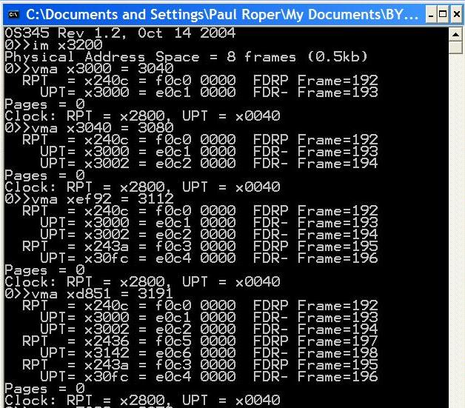
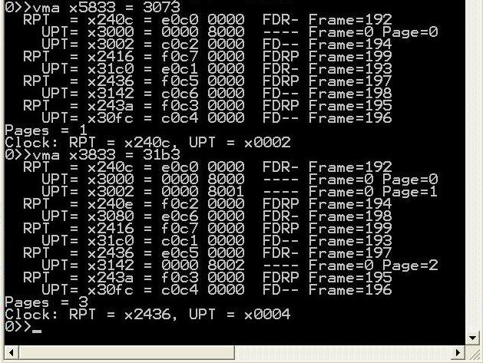
Exercise Demo
Notes:
28

Slide 29
unsigned short int *getMemAdr(int va, int rwFlg) { if (va < 0x3000) return &memory[va]; // turn off virtual addressing for system RAM rpta = tcb[curTask].RPT + RPTI(va); rpte1 = MEMWORD(rpta); rpte2 = MEMWORD(rpta+1); if (DEFINED(rpte1)) { // rpte defined } else // rpte undefined 1. get a UPT frame from memory (may have to free up frame) { // 2. if paged out (DEFINED) load swapped page into UPT frame // else initialize UPT frame = getFrame(-1); rpte1 = SET_DEFINED(frame); if (PAGED(rpte2)) // UPT frame paged out - read from SWAPPAGE(rpte2) into frame { accessPage(SWAPPAGE(rpte2), frame, PAGE_READ); } else // define new upt frame and reference from rpt { rpte1 = SET_DIRTY(rpte1); rpte2 = 0; // undefine all upte's } } MEMWORD(rpta) = rpte1 = SET_REF(SET_PINNED(rpte1)); // set rpt frame access bit MEMWORD(rpta+1) = rpte2; upta = (FRAME(rpte1)<<6) + UPTI(va); upte1 = MEMWORD(upta); upte2 = MEMWORD(upta+1); if (DEFINED(upte1)) { // upte defined } else // upte undefined 1. get a physical frame (may have to free up frame) (x3000 - limit) (192 - 1023) { // 2. if paged out (DEFINED) load swapped page into physical frame // else new frame } return &memory[(FRAME(upte1)<<6) + FRAMEOFFSET(va)]; // return physical address} }
unsigned short int *getMemAdr(int va, int rwFlg)
MMU turned off for system access
Hit!
Page Fault
Go get a Frame
UPT Page in swap space
Frame referenced
New UPT Frame
Hit!
Page Fault
Notes:
29

Slide 30
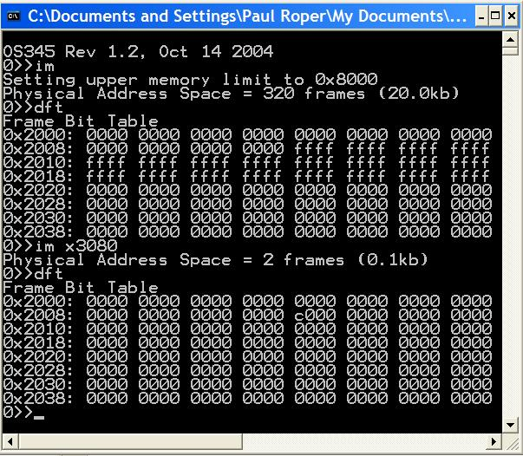
Frame Bit Table
0x3000
0x8000
2 Frames

Slide 31
accessPage
// ********************************************************************************************
// read/write to swap space
int accessPage(int pnum, int frame, int rwnFlg)
{ static unsigned short int swapMemory[LC3_MAX_SWAP_MEMORY];
switch(rwnFlg)
{ case PAGE_GET_ADR: // return page address
{ return (int)(&swapMemory[pnum<<6]);
}
case PAGE_NEW_WRITE: // new write
{ pnum = nextPage++;
}
case PAGE_OLD_WRITE: // write
{ memcpy(&swapMemory[pnum<<6], &memory[frame<<6], 1<<7);
return pnum;
}
case PAGE_READ: // read
{ memcpy(&memory[frame<<6], &swapMemory[pnum<<6], 1<<7);
return pnum;
}
}
return pnum;
}

Slide 32
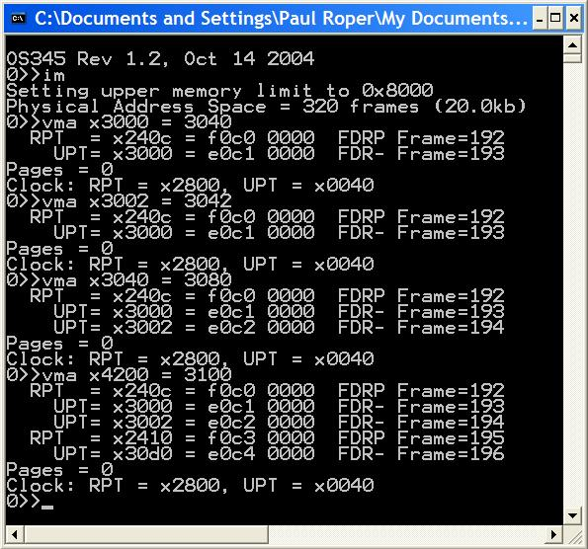
vma
2 frames – UPT, Frame
No new frames
Same UPT, new Frame
No swap pages
New UPT, new Frame
Clock did not advance

Slide 33
Virtual Memory Guidelines
Verify a clean compilation of your LC-3 virtual memory simulator. Validate that “crawler.hex” and “memtest.hex” programs execute properly.
Modify the getMemAdr() function to handle a 2-level, paging, virtual memory addressing.
Implement a clock page replacement algorithm to pick which frame is unloaded, if necessary, on a page fault.
Use the provided 1MB page swap table routine to simulate paged disk storage (8192 pages) or implement your own routine.
Use crawler.hex and memtest.hex to validate your virtual memory implementation. Use other routines (such as im) to debug you implementation.

Slide 34
Virtual Memory Guidelines
Use the following CLI commands to verify and validate your virtual memory system. (Most of these routines are provided, but may require some adaptation to your system.)
dfm <#> Display LC3 memory frame <#>
dft Display frame allocation table
dm <sa>,<ea> Display physical LC3 memory from <sa> to <ea>
dp <#> Display page <#> in swap space
dv <sa>,<ea> Display virtual LC3 memory <sa> to <ea>
im <ea> Init LC3/Set upper LC3 memory limit
rpt <#> Display task <#> root page table
upt <p><#> Display task <p> user page table <#>
vma <a> Access <a> and display RPTE’s and UPTE’s
vms Display LC3 statistics

Slide 35
Virtual Memory Guidelines
Demonstrate that LC-3 tasks run correctly. Be able to dynamically change LC-3 memory size (im command) and chart resulting changes in page hits/faults. Memory accesses, hits and faults are defined as follows:
Memory access (memAccess) = sum of memory hits (memHits) and memory faults (memPageFaults).
Hit (memHits) = access to task RPT, UPT, or data frame. (Exclude accesses below 0x3000.)
Fault (memPageFaults) = access to a task page that is undefined or not currently in a memory frame.
Page Reads (pageReads) = # pages read from swap space into memory.
Page Writes (pageWrites) = # pages written from memory to swap space.
Swap Page (nextPage) = # of swap space pages currently allocated to swapped pages.
 | Crawler |  |  | Memtest
Frames: | 320 | 16 | 2 | 320 | 16 | 2
Accesses:
Hits:
Faults:
Page Reads:
Page Writes:
Swap Pages:

Slide 36
Project 4 Grading Criteria
REQUIRED:
4 pts – Successfully execute crawler and memtest in 20k words (320 frames).
3 pts – Successfully execute crawler and memtest in 1k words (16 frames).
1 pt – Successfully execute 5 or more LC-3 tasks simultaneously in 16 frames of LC-3
memory.
1 pt – Correctly use the dirty bit to only write altered or new memory frames to swap
space.
1 pt – Chart and submit the resulting memory access, hit, fault, and swap page statistics
after executing crawler (and then memtest) in 320 and 16 frames (vms).
BONUS:
+1 point – early pass-off (at least one day before due date.)
+1 point – Add a per/task frame/swap page recovery mechanism of a terminated task.
+1 point – Implement the advanced clock algorithm and chart the results.
+1 point – Join the 2-frame club. (Successfully execute 5 or more LC-3 tasks
simultaneously in 2 frames of LC-3 memory. Chart the memory accesses,
hits, and faults.)
–1 point penalty for each school day late.

Slide 37
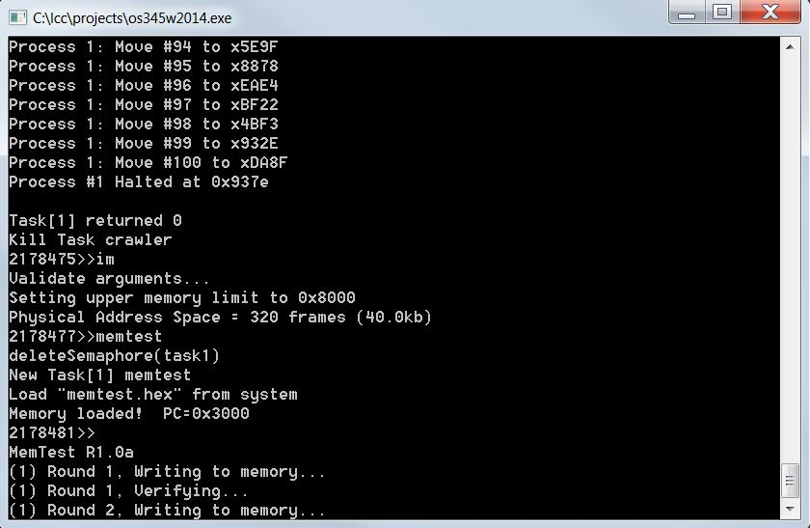
Step 1 – Virtual Memory
1. Validate that the demo LC-3 simulator works for a single task with pass-through addressing (virtual equals physical) for the LC-3 by setting MMU_ENABLE to 0 and executing the commands “crawler” and “memtest”.
#define MMU_ENABLE 0
unsigned short int *getMemAdr(int va, int rwFlg)
{
unsigned short int pa;
// turn off virtual addressing for system RAM
if (va < 0x3000) return &memory[va];
#if MMU_ENABLE
#else
// calculate physical from virtual virtual
pa = va;
#endif
// return physical memory address
return &memory[pa];
} // end getMemAdr

Slide 38
Step 2 – Virtual Memory
2. Implement page fault frame replacement using available memory frames only.
Modify createTask() to allocate an unique Root Page Table for each task. (ie, tcb[tid].RPT = LC3_RPT + ((tid) ? ((tid-1)<<6) : 0);)
Fix getMemAdr such that if root page table entry undefined, use getFrame to return a new UPT frame from available memory and initialize all user page table entries.
Fix getMemAdr such that if user page table entry undefined, use getFrame to return a new data frame from available memory.
This should allow you to execute any test program in a full address space.

Slide 39
Step 3 – Virtual Memory
Implement clock page replacement algorithm to unload data frames to swap pages and reload with a new frame or an existing frame from swap space if needed.
Create and validate a “clock” mechanism that accesses all global root page tables, user page tables, and data frames.
Swap to swap space the first frame with the reference bit equal to zero (and not equal to the notme frame).
Advance the clock.
Return frame number for use as a UPT or data frame.
Use the vma function to access a single virtual memory location and then display any non-zero RPT and UPT entries.
This should allow you to execute all the test programs in a 32k word address space (20k of paging frames).

Slide 40
Step 4 – Virtual Memory
Implement clock page replacement algorithm to unload User Page Tables when there are no physical data frame references in the UPT. This will be necessary when running in a small physical space (16k words) with multiple tasks.
If a User Page Table does not have the reference bit set AND does not have any entries with in-memory frame bit set AND if not the notme frame, swap to swap space.
Advance the clock.
Return frame number for use as a UPT or data frame.
When swapping a user page table to swap space, add some debug “sanity check” code to validate that the UPT does not have any entries with the frame bit set.
Use the vma function to access a single virtual memory location and then display any non-zero RPT and UPT entries.
5. Implement dirty bit to minimize writing frames to swap space.

Slide 41
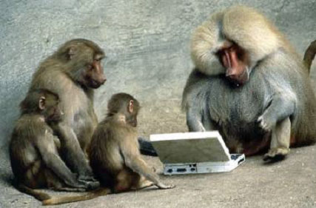
Notes:
Paul Roper
41

Slide 42
LC-3 Simulator
MAR access thru getMemAdr(va, rwflg)
MDR access thru getMemData(va)
setMemData(va)
Notes:
42

Slide 43
So…
1. Read and comprehend Stallings, Section 8.1.
2. Comprehend the lab specs. Discuss questions with classmates, the TA’s and/or the professor. Make sure you understand what the requirements are! It's a tragedy to code for 20 hours and then realize you're doing everything wrong.
3. Validate that the demo LC-3 simulator works for a single task with pass-through addressing (virtual equals physical) for the LC-3 by executing the commands “crawler” and “memtest”.
4. Design your MMU. Break the problem down into manageable parts.
5. Create and validate a “clock” mechanism that accesses all global root page tables, user page tables, and data frames.
6. Implement dirty bit last – use “write-through” for all swapping of a data frame to swap space.

Slide 44
So…
7. Incrementally add support for the actual translation of virtual addresses to physical addresses with page fault detection as follows:
a. Implement page fault frame replacement using available memory frames only. This should allow you to execute any test program in a full address space.
b. Implement clock page replacement algorithm to unload data frames to swap pages and reload with a new frame or an existing frame from swap space. This should allow you to execute all the test programs in a 32k word address space (20k of paging frames).
c. Implement clock page replacement algorithm to unload User Page Tables when there are no physical data frame references in the UPT. This will be necessary when running in a small physical space (16k words) with multiple tasks.
d. Implement dirty bit to minimize writing frames to swap space.

Slide 45
So…
Remember to always increment your clock after finding a replacement frame.
Use the vma function to access a single virtual memory location and then display any non-zero RPT and UPT entries. Implement various levels of debug trace to watch what is going on in your MMU. You may use the provided display functions.
When swapping a user page table to swap space, add some debug “sanity check” code to validate that the UPT does not have any entries with the frame bit set.

